Slide 1
Cannon Elementary - A GCISD STEM School
Curriculum Night
LA/SS - Erin Lambert, Alejandra Paniagua
Math/Science - Esther Nuhu, Julee Vorachard

Slide 2
Humanities
Reading / Writing
Workshops
25 Book Challenge
Words Their Way Spelling
Sight Words Spelling
Social Studies
Texas History

Slide 3
Math & Science
Math
Science

Slide 4
STEM - Engineering + Curriculum
​

Slide 5
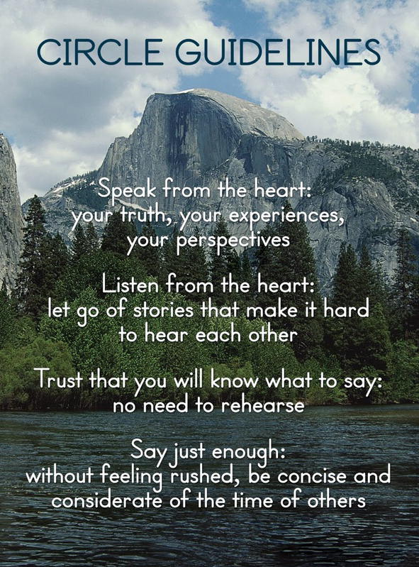
Restorative Practices
District-Wide Initiative
Program by The Institute for
Restorative Communities
Purpose / Goal
Circle Up
Notes:
* Restorative Practices - be sure to give a brief explanation of this and the overall goal. Address Circle Up time and purpose; mention that this is a district-wide initiative being used at all schools.

Slide 6
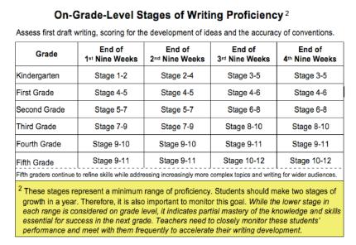
Testing
Reading / Writing
Writing Assessment
Sept. 2-26-BOY
Dec. 8-Jan. 16-MOY
May 4-29-EOY
ACT Aspire
STAAR
Writing-March 30/April 1
Math-April 21
Reading-April 22

Slide 7
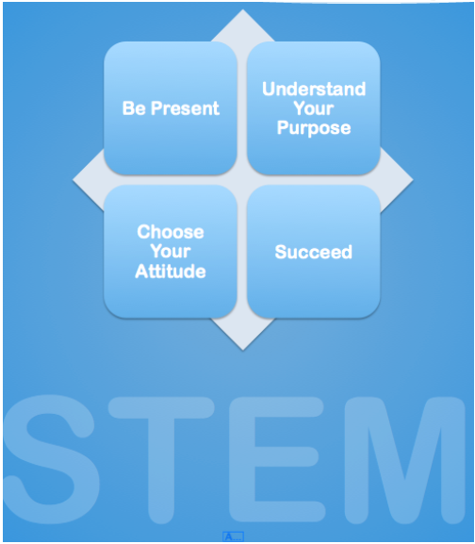
Classroom Expectations

Slide 8
iPads

Slide 9
Homework Expectations
Take Home Folder
Reading Log
Please initial daily
Weekly Spelling
Weekly Math

Slide 10
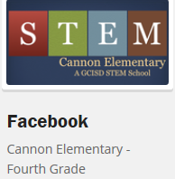
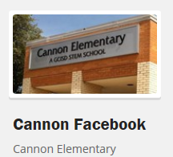
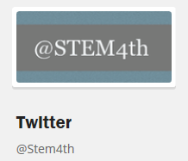
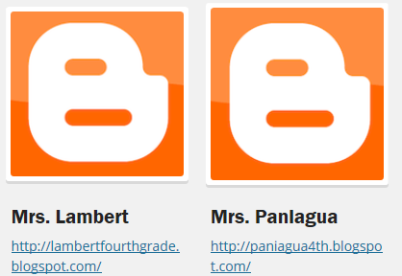
Communication

Slide 11
Family Nights
FAMILY ENGINEERING NIGHT - November 13th
OPEN HOUSE- March 5th
FAMILY MAKER-FAIRE NIGHT - May 14th

Slide 12
Conferences
Conference Time - 8:10-9:00
Parent/Teacher Conferences - As Needed
Student-Led Conferences
October 8th and 9th
February 18th and 19th

